Slide 1
Department of MCA
Advanced Programming -22MCA303
Handling By
Nirupama K
Asst. Prof. Dept. of MCA

Slide 2
Advanced Programming -22MCA303
Module 1 | Getting started with .NET Framework 4.0 and C#

Slide 3
What is .NET ?
Microsoft.NET is a Framework
Microsoft .NET is a Framework which provides a common platform to Execute or, Run the applications developed in various programming languages.
The main intention was to bridge the gap in interoperability between services of various programming languages.

Slide 4
Introduction
.Net framework is an essential component of window operating system
Programming languages C#, J#, VB and Visual C++
3 important components CRL, CLS, CTS
.Net framework is a bridge between applications which are created using C#, Visual Basic
Evolution
Mid 90s java was popular to develop the application
2002 J2EE introduced
February 10 2002 .Net framework 1.0 released along with visual studio IDE
Advanced Programming -22MCA303
khande@358

Slide 5
.NET Framework Objectives
The .NET Framework is designed to fulfill the following objectives:
Provide object-oriented programming environment
Provide environment for developing various types of applications, such as Windows-based applications and Web-based applications
To ensure that code based on the .NET Framework can integrate with any other code
Notes:
Faculty Notes:

Slide 6
Benefits of .NET Framework
Consistent Programming Model- Provides a consistent object-oriented programming model across different languages.
Cross-platform support- specifies that any window platform that support CLR can execute .NET application, that is, .NET application enables interpretability between multiple windows operating system.
Language Interpretability- Enable code written in different language to interact with each other .
Automatic Management of Resources- Specifies that in .NET you do not need to manually free the application resources, such as files, memory, network and database connection.
Ease of deployment - specifies that the .NET framework install applications or components that do not effect the existing application

Slide 7
. NET Framework
VB
C++
C#
JScript
…
Visual Studio 2008
Common Language Specification
ASP.NET
Windows Forms
ADO.NET
Base Class Library
(CLR) Common Language Runtime
Operating System
Notes:
Faculty Notes:
Figure above illustrates the Microsoft .NET Framework. All .NET languages are built on a Common Language Specification. While designed specifically to support the .NET versions of Visual Basic, C++, C# and JScript, .NET also supports other languages that can be modified to this specification. These include Perl, Python, COBOL, Eiffel, Pascal, Fortran, SmallTalk, Java, RPG, Ada, APL, J# and others.
The .NET Framework is designed to unify programming models to enable cross-language integration.
The Microsoft Active Server Page (ASP) technology has been enhanced as ASP.NET and is designed to allow the easy development of Web services and Web forms see figure above. The development of Windows forms has also been improved with .NET, and ADO.NET provides full support for data and XML. Visual Studio 2005 supports and integrates all of these development environments, automating many development tasks that previously required manual integration.
Each of the languages in the figure is supported by Visual Studio 2005, which is an enhanced IDE. The other languages discussed earlier can also be added to Visual Studio 2005. The strategy behind Visual Studio 2005 is to enable applications to be developed within Windows for later execution in a .NET environment on any platform.

Slide 8
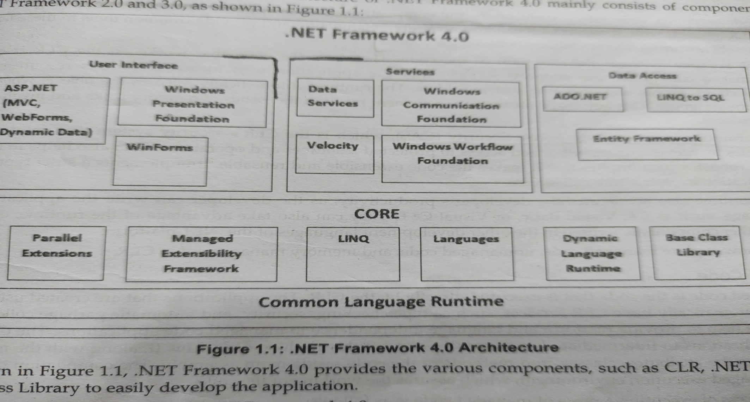
. NET Framework architecture

Slide 9
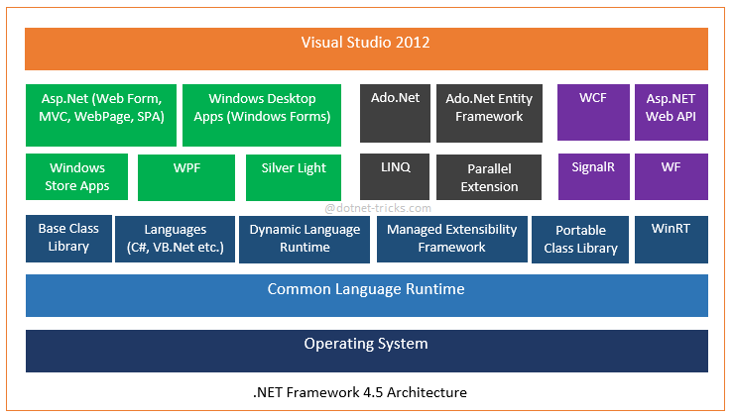

Slide 10
The Components of .NET Framework :
Common Language Runtime (CLR)
Most important component of .Net framework
Memory management, exception handling, debugging, security, thread execution
Managed code- executes directly by the CLR- selecting language compiler, compiling the code to IL, compiling IL to native mode, execute the code
CLR also support for various resources such as collections, arrays, operating system folder
Runtime automatically releases the object when they are no longer in use
Unmanaged code
Common type specification (CTS)
CTS specifies certain guidelines for declaring, using and managing types at runtime
Helps in cross language specification
.
Notes:
Faculty Notes:
Just read out the slide the sub point are explained in next slide

Slide 11
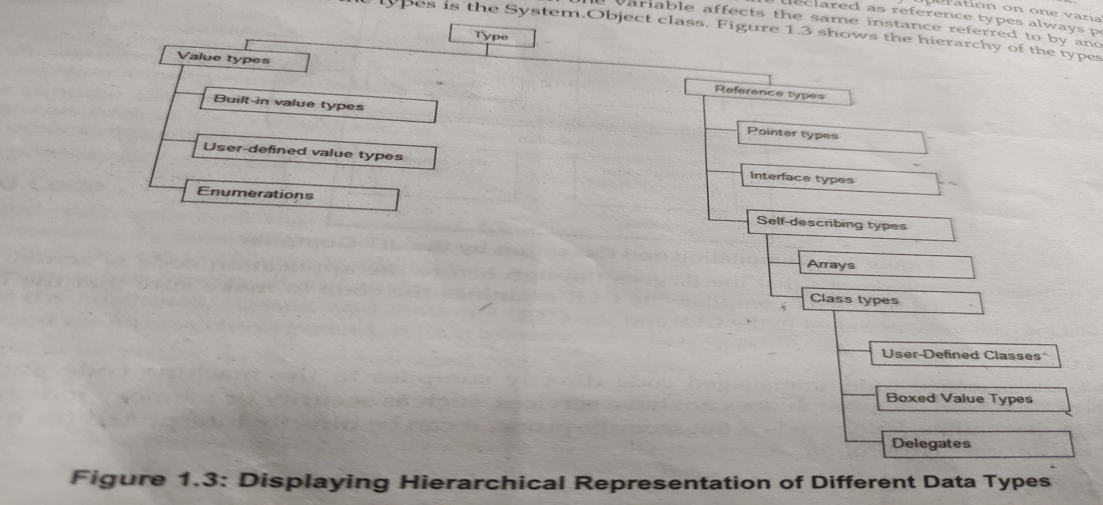
CTS
Support Object oriented model for implementation of different programming languages
Support primitive data types

Slide 12
Common Language Specification
CLS performs the following functions:
Establishes a framework that helps enable cross-language integration, type safety, and high performance code execution
Provides an object-oriented model that supports the complete implementation of many programming languages
Defines rules that languages must follow, which helps ensure that objects written in different languages can interact with each other

Slide 13
Other components of framework
Metadata and Assemblies
.NET framework class library
Windows forms
ASP .NET and ASP .NET AJAX
ADO .NET- disconnected architecture, cached data in dataset, scalability and transfer of data in XML format
Window Workflow Foundation
Window Presentation Foundation
Window Communication Foundation
Windows CardSpace
LINQ

Slide 14
Execution in CLR
Source code
VB
C#
C++
Compiler
Compiler
Compiler
Managed
code
Assembly
IL Code
Assembly
IL Code
Assembly
IL Code
Common Language Runtime
JIT Compiler
Native Code
Operating System Services
Notes:
Faculty Notes:
We already know that an assembly does NOT contain native binary code, but instead MSIL code. Obviously before the MSIL code can be executed it must be converted into native binary instructions. Converted? Does this mean interpreted? NO! The MSIL code is compiled and not thrown away. This means that the next time the code is requested it is already in the form of machine instructions and thus this mechanism in the log run is far more efficient than an interpreter for example.
The compilation is carried out by a JIT (Just In Time) compiler. Does the compiler compile all of the code in one go? The answer to this question is NO. If this approach was taken there would be a long delay during the applications initialization, and realistically not all the code within the module will be required in one go. Instead, when the code is loaded a ‘stub’ is connected to each method. When a method is called via the stub the compiler generates the binary native code. This mechanism goes a long way to describing why the compiler is called a ‘JIT’ compiler.
Compiled code is only saved in the same process (run) of an application. And even then it's not guaranteed. We do what's called "code-pitching" which means we through away cold (or little used) JITed code if memory pressure requires it. We do persisted JITed code in the install time scenario.
The benefit to this system is obviously portability. A couple of things to think about -
Let’s imagine you’ve built a managed component for the Intel Pentium III platform. It works fine. Later in the year Intel released a super new chip. When Microsoft released a new version of the JIT, it’s possible that this brand spanking new version of the JIT will have learned a few new tricks e.g. to make use of the new improved instruction set of the new Intel chip or new CPU registers!
And finally, Microsoft plans to offer a tool called PREJIT. This tool will compile your assemblies into native code and save the resultant binary executable code to disk. When the assemblies are next loaded the binary code is already available thus improving startup time and execution speeds.

Slide 15
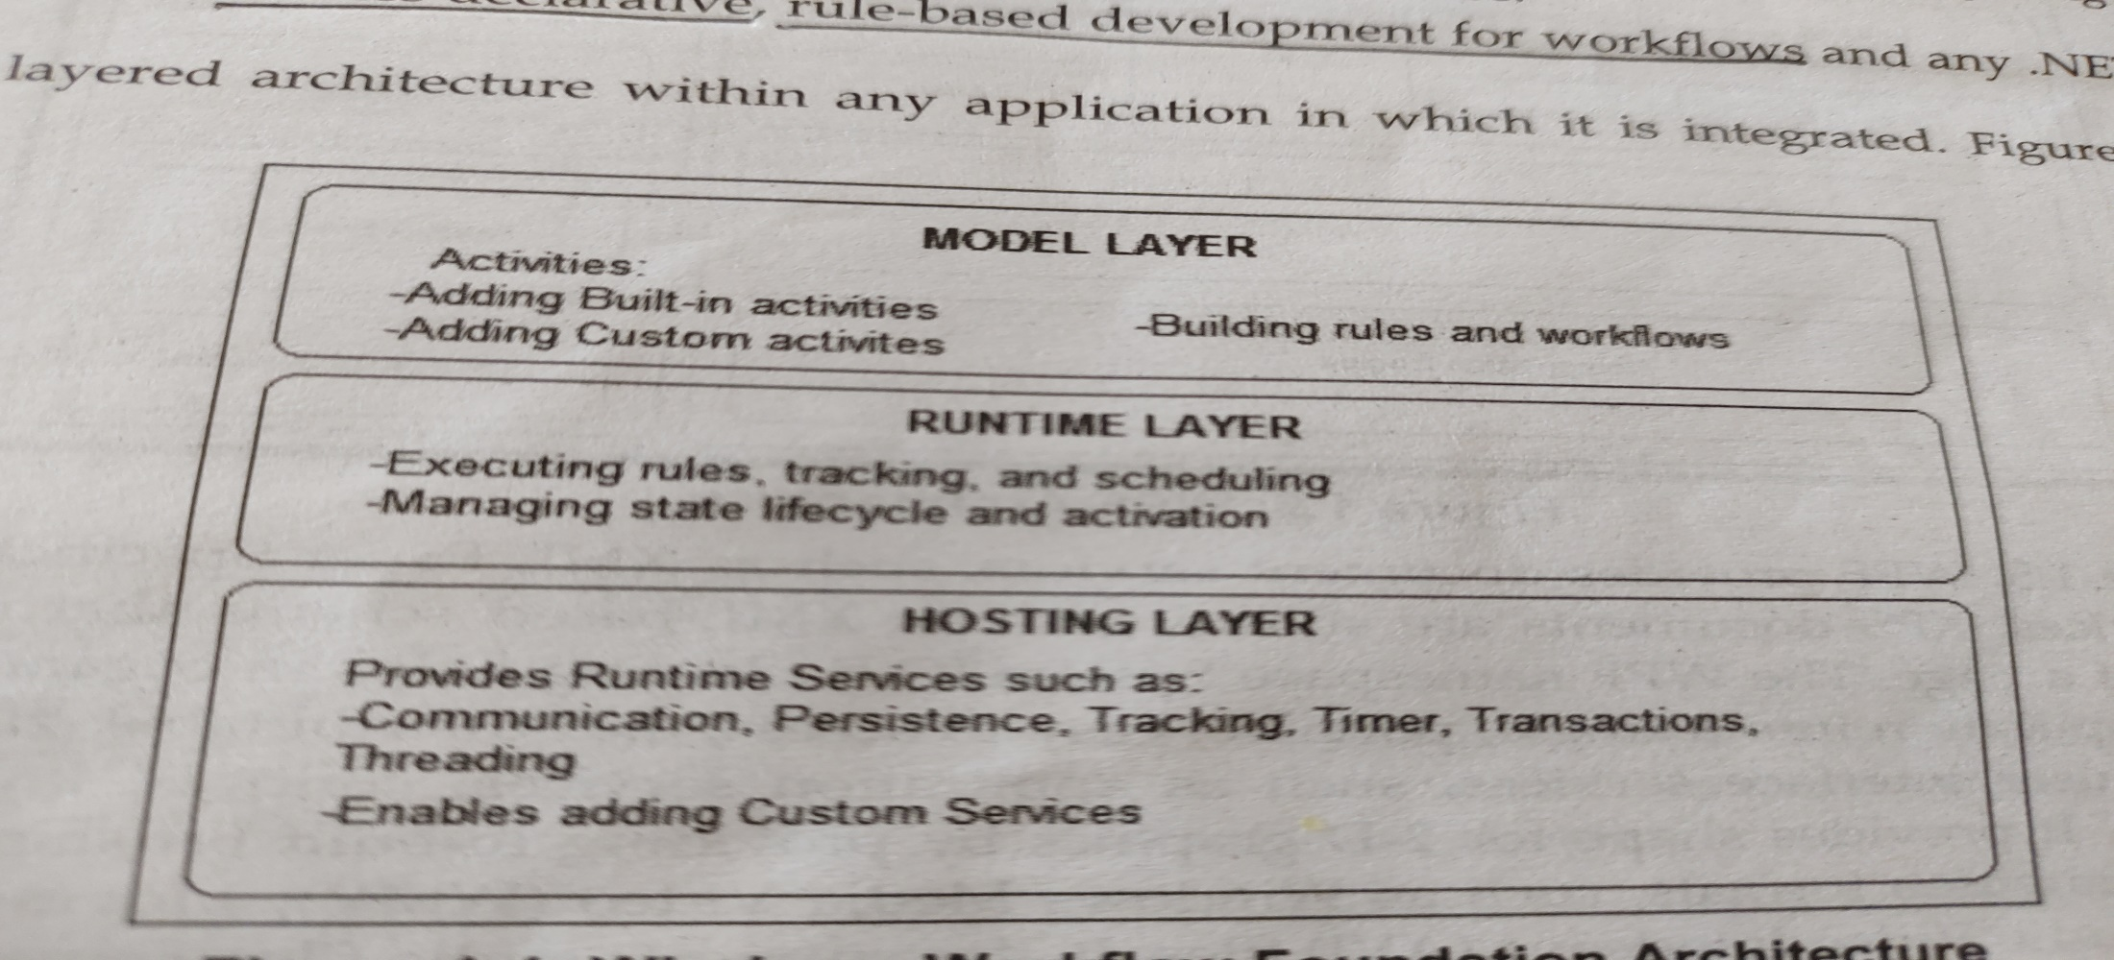
Windows Workflow Foundation (WWF)
Activities
Workflow designer
Workflow Runtime
Rules Engine

Slide 16
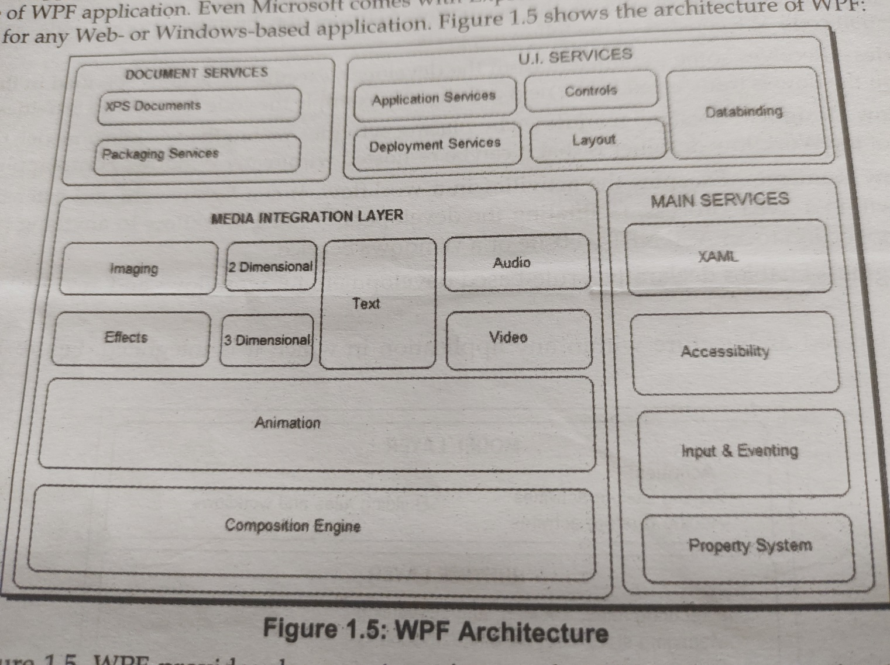
Windows Presentation Foundation (WPF)

Slide 17
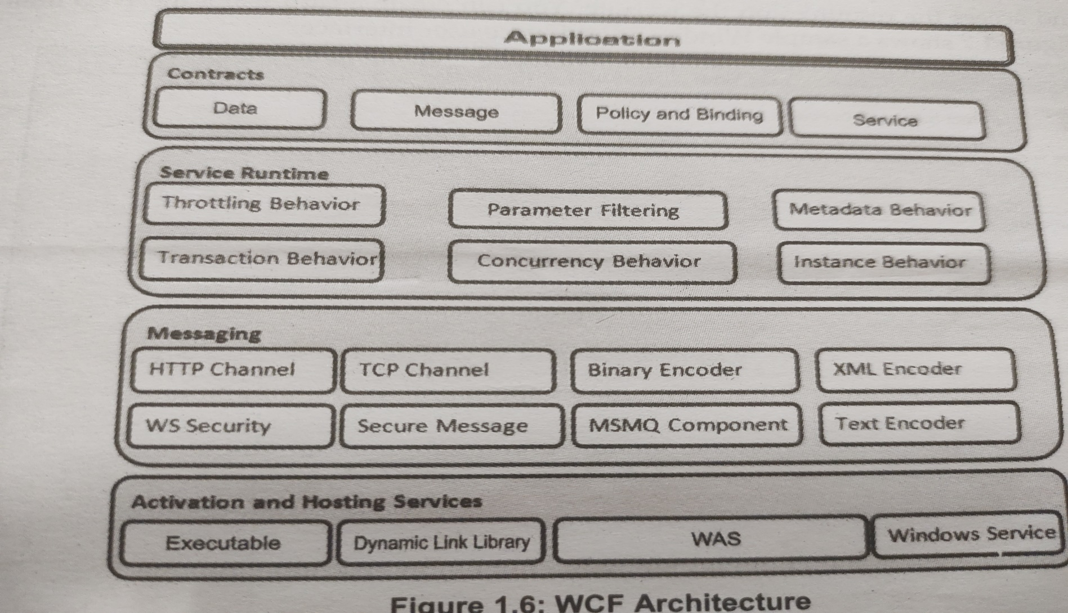
Windows Communication Foundation (WCF)

Slide 18
Exploring the features of Net Framework
Improvement in the application compatibility and deployment
Dynamic language runtime
Managed extensibility framework
Parallel computing
Improved security model
Networking improvement
Improvement in WPF
Improved entity framework
Integration of WCF and WF
Improved code ASP .Net services

